Slide 1
The Vine Inter-Church Primary School
GOING TO BURWELL
Tuesday 5th January – Thursday 7th January 2027

Slide 2
Aims of the PowerPoint
To share with you…
- About Burwell House
Our activities
Expectations of behaviour
Where/when we will be sleeping
Medical information
Contact information
All the little things we need to know

Slide 3
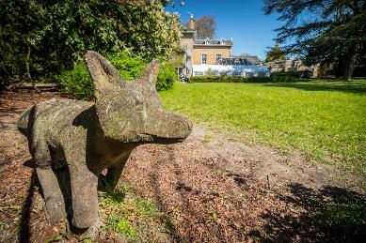
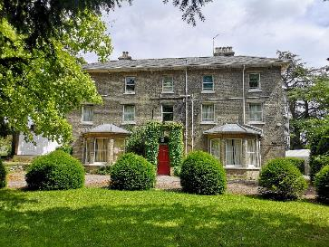
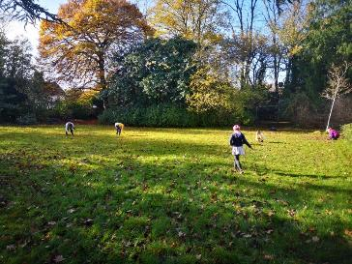
Welcome Home
Notes:
…because one of the most important things about our Centre is that it will feel like the home that it once was. This comes from the nature of the property (no soulless institution this!) and from the staff – who are lovely!

Slide 4
Why is this visit important?
“The first-hand experiences of learning outside the classroom can help to make subjects more vivid and interesting for pupils and enhance their understanding.” Ofsted
The Council for Learning Outside the Classroom (CLOTC) recognises that Learning outside the classroom:
  gives children new and exciting experiences that inspire them to reach their true potential.
  serves to re-motivate children who do not thrive in the traditional classroom environment
  encourages children to become more engaged in their education both inside and outside the classroom walls.
  increases self esteem, confidence, confidence and results – a proven link between high quality residentials and achievement.
“Trips help us to learn more stuff than we can in the classroom.”
(Primary pupil, Ofsted)
Notes:
Ofsted place real (and increasing ) value on well planned residential and off-site learning visits.
There are very clear (and proven) links between LOTC and motivation, engagement, self esteem, confidence, results. It is worth it.

Slide 5

Why is this visit important (part 2)
“A residential learning experience provides opportunities, benefits and impacts that cannot be achieved in any other educational
context or setting.”
Learning Away report, 2016
Notes:
Overwhelming evidence that Residentials increase:
Attainment (results)
Engagement with learning,
Relationship (with other pupils and with staff),
Resilience and self confidence
Throughout whole trip, children encouraged to be responsible, respectful and given chance to work in teams

Slide 6
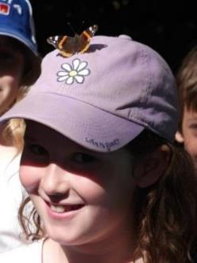
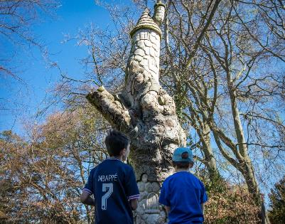
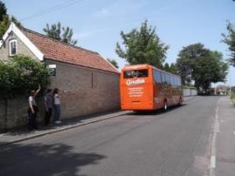
“This visit has been the most organised, enjoyable and fun residential trip we have ever been on. A huge thanks”
“Friendship, team building skills, table manners improved, tried new things.
Overall a really great first experience of being away from home for the children”
Notes:
Quotes and questions

Slide 7
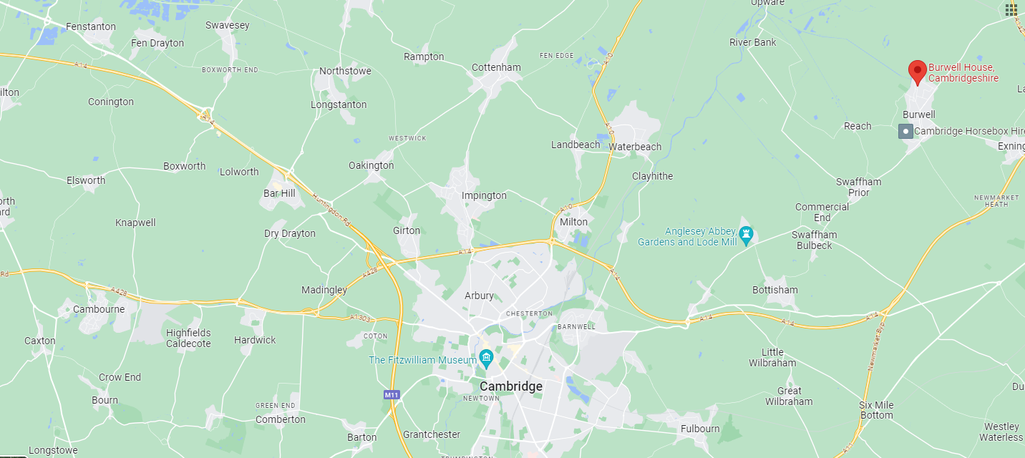
Where are we?
Notes:
Rural and tranquil, yet accessible. Village location approx. 10 minutes from A14, 10 miles from Cambridge.

Slide 8
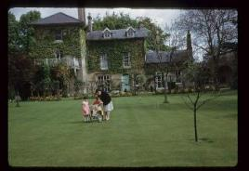
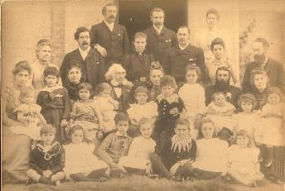
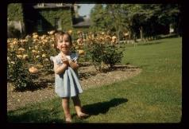
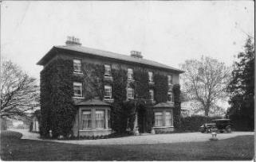
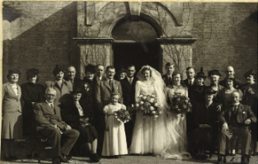
A family home, built in 1787…
…enjoyed for generations…
Notes:
Built by a local MP and landowner in 1787. Passed through and enjoyed by many generations of many families – a happy house. oozing w.ith character and warmth

Slide 9
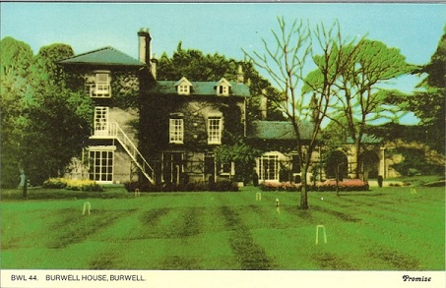
1964. A new purpose…
Bought by Cambridgeshire County Council for £15,000 to be enjoyed for generations to come.
Notes:
What a bargain!
First visitors were a group of Russian exchange students in June 1965.

Slide 10
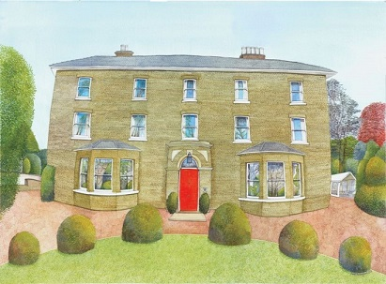
Today
Burwell House welcomes around 80 primary schools on residential visits each year, from right across East Anglia, and beyond.
Along with the wide variety of youth and adult groups who use the Centre at weekends and during the school holidays we host a total of 4000 visitors per year.
Schools staying with us have:
Sole residential occupancy – each school staying here will be the only school staying here.
Use of our fantastic house and its 3 acres of wonderful gardens.
Support from a caring, professional Centre staff team.
Freedom to plan a timetable that suits their curriculum, their topics and their individual children – our courses are built for your school.
Notes:
Many good reasons why schools choose to stay here, and many schools choose to do so.

Slide 11


High quality, accredited service
One of the 3 Centres within this partnership (Burwell House, Grafham Water Centre and Stibbington) all working together to bring learning to life for children from Cambridgeshire and beyond.
Awarded the LOTC quality badge in recognition of the high standards of safety, value and quality that our Centre provides.
Notes:
Quality badge assessment is a rigorous procedure

Slide 12
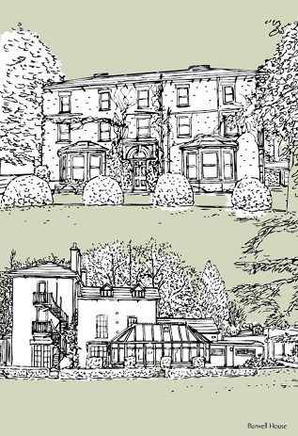
The House
No longer a family home - though all the staff strive to make it feel like one.
Grand, beautifully decorated, comfortable, warm, and homely.
Protected by modern, sensitive fire alarm system and sprinklers.
Secure – house is locked overnight by school staff, with grounds secured behind large wall and locked gates.
Notes:
Beautiful old house ( a real wow factor) but equipped with modern safety features and comforts.

Slide 13
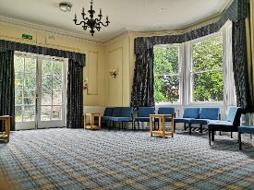
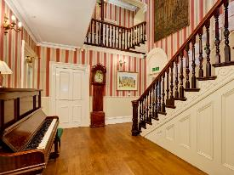
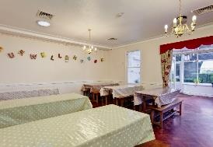
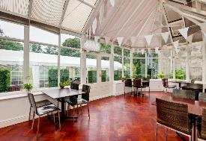
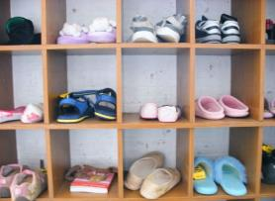
Downstairs
2 large lounges and a separate classroom.
Separate toilets for boys, girls and accompanying adults.
Cloakroom.
Dining room and conservatory
Notes:
The lounge is the main indoor base for schools, a comfortable base with room for the whole group to relax (contains TV, DVD)
A number of other downstairs spaces.
Additional room available as downstairs bedroom with accessible facilities if required.

Slide 14
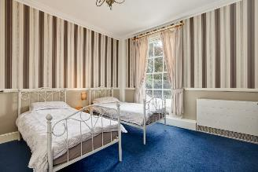
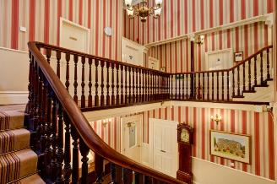
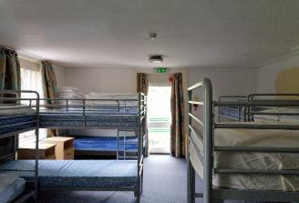
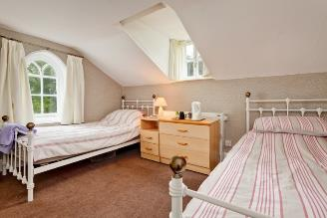
Upstairs
11 bedrooms in total, of various different shapes and sizes.
All with close access to their own shower and toilet facilities.
Notes:
Children’s rooms are nearby to adults rooms.
7 children’s bedrooms (containing 4 – 14 beds),
Each room has a sink, and either en-suite shower and toilet facilities or very nearby
Rooms have mainly bunk beds – all bedding is provided (not feather).
Children need to bring own towels & wash kit
School staff allocate children to each room.

Slide 15
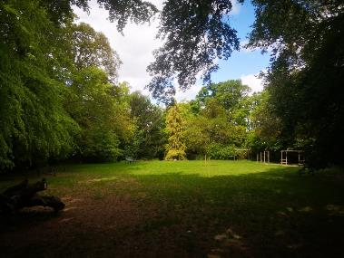
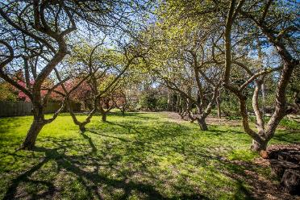
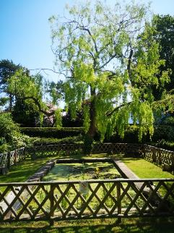
The gardens
3 acres of secure, inspiring, exciting, magical space for children to play, learn, explore, invent, have fun and let off steam.
Notes:
Whatever the time of year, the gardens are a great asset - Three acres of landscaped gardens
Offer relaxed, informal setting – lots of sculptures and fun things to discover, and a wildlife haven (deer, birds, hedgehogs)
Secure and safe walled grounds.
Children will play & explore during their free time.

Slide 16
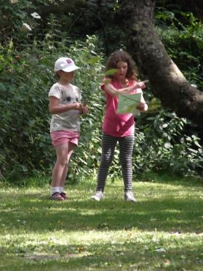
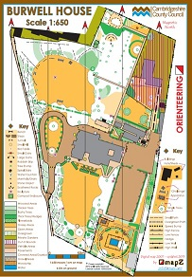
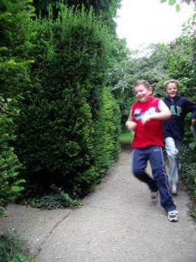
Explore
“The children worked exceptionally well together, particularly those who have never really engaged with each other”
Mapwork and Orienteering
A range of activities to learn and develop a variety of mapwork skills in and around the garden and out into the village and local area.
Notes:
An excellent garden for learning about and developing mapwork skills (far superior to very familiar school grounds)
Variety of trails around the garden, designed to practice different map skills.
Additional mapwork opportunities in and around Burwell and the local area.

Slide 17
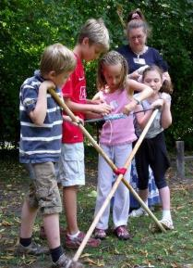
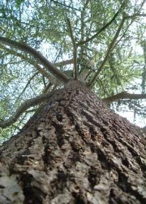
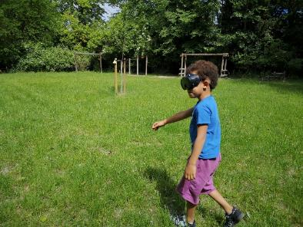
Explore
A range of activities designed to help children explore their surroundings, explore the environment, and to explore their own skills and abilities – working independently and in teams.
“They have been given such a range of opportunities to use their group work skills. Every child has had a chance to shine out through the wide range of activity types.”
Notes:
Explore the environment (bushcraft, sensory games, den building,)and explore your own abilities (through teambuilding, sensory games etc)
Team building is at the heart of every course through all of the activities at the Centre,

Slide 18
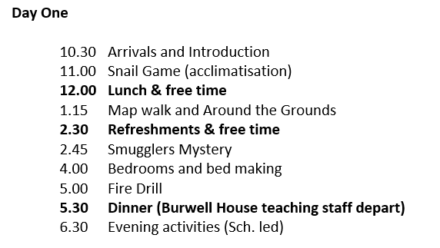
Example Activities
Notes:
Wide variety of options
Activity programme individually planned with school staff
Adapted to individual requirements of school
Activities linked to National Curriculum
Aim to enhance / extend classroom learning
Sample timetable sets out the way a day is normally planned out.

Slide 19
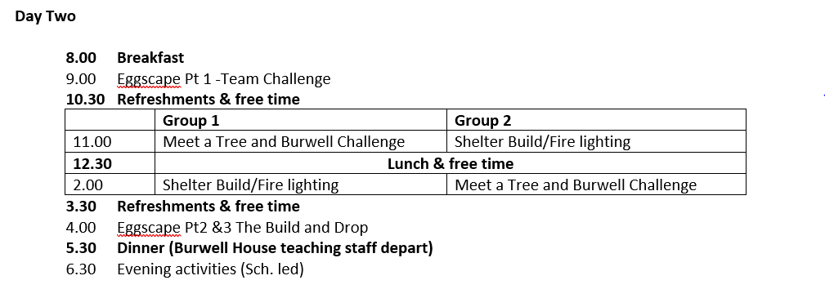
Example Activities
Notes:
Wide variety of options
Activity programme individually planned with school staff
Adapted to individual requirements of school
Activities linked to National Curriculum
Aim to enhance / extend classroom learning
Sample timetable sets out the way a day is normally planned out.

Slide 20
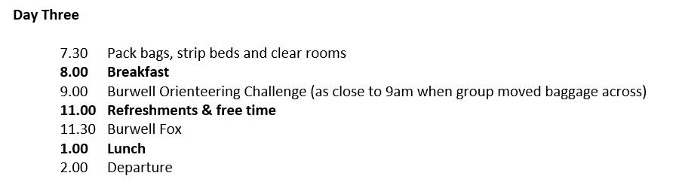
Example Activities
Notes:
Wide variety of options
Activity programme individually planned with school staff
Adapted to individual requirements of school
Activities linked to National Curriculum
Aim to enhance / extend classroom learning
Sample timetable sets out the way a day is normally planned out.

Slide 21
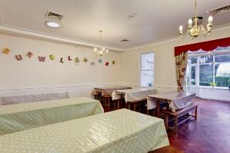
Food!
A range of delicious and nutritious home cooked food will be served for breakfast, lunch and evening meal.
Good table manners are expected.
Snacks - these are provided throughout the day – there is no need to pack any for the trip.
Notes:
Breakfast, dinner & tea all served in dining room
Sit in small “family” table groups
Children fully involved in serving each other, clearing away & setting up for the next meal
Burwell House has good reputation for delicious, healthy food.
Refreshments served mid-morning (with biscuit) / afternoon (with fruit)
Special diets catered for.
We encourage all children to give things a try – and very regularly find that in the supportive environment amongst their friends, that children will give things a go. But we’ll always have an alternative if they absolutely refuse – we aren’t going to let any child go hungry!
Cooks enjoy making birthdays special - Home-made birthday cakes provided if needed.

Slide 22
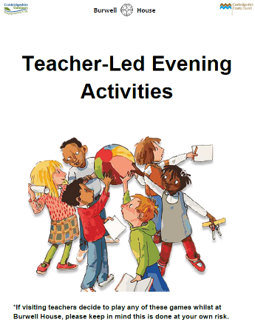
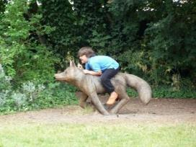
Evenings and overnight
House and grounds provide hours of fun and enjoyment.
Sole group use – no other schools on site.
Secure accommodation.
Notes:
Run by school staff
Souvenir shop
Diaries, free time, bat detectors, play piano, games, campfire, stargazing.

Slide 23
Sleeping Arrangements
Pupils will be asked to select 3 friends they would like to be in a room with. They will be guaranteed at least one of these.
Rooms are split into boys and girls.
School staff rooms are located in nearby rooms.

Slide 24
The Vine staff joining Year 4 at Burwell House
Mr Johnson
Miss Smalley
Mrs Wales
Mrs Bate
+1 other each day
Notes:
Qualified and experienced teachers – all who are excellent.
1 will coordinate and lead most of the teaching input
Get to know and interact with the children on an individual basis

Slide 25
Behaviour
We expect children to follow the school rules AND the Burwell House rules so that we can be safe, happy and have fun.
Be kind and gentle
Be helpful
Listen
Learn
Be honest
And look after the environment.
Notes:
Qualified and experienced teachers – all who are excellent.
1 will coordinate and lead most of the teaching input
Get to know and interact with the children on an individual basis

Slide 26
Behaviour
We want everybody to have safe and enjoyable time at Burwell and if anyone behaves in a way that may jeopardise the safety and/ or enjoyment of themselves or others, the Burwell and Vine staff reserve the right to exclude any individual or group from the visit.
In pupil speak: your parents/ carers will have to come and collect you if you are not behaving appropriately.
Notes:
Qualified and experienced teachers – all who are excellent.
1 will coordinate and lead most of the teaching input
Get to know and interact with the children on an individual basis

Slide 27
Medical Information
We will be sending out specific medical forms very soon!
Prescribed medication only (completed on the medical form)
Enough for 3 days, 2 nights.
Given to a member of staff on the morning of our departure; if you want to do this beforehand you can.
Original container and clearly labelled with child’s name and dosage.
Please make us aware of travel sickness.
Notes:
Qualified and experienced teachers – all who are excellent.
1 will coordinate and lead most of the teaching input
Get to know and interact with the children on an individual basis

Slide 28
Contact
In the unlikely event of an emergency, staff will contact the school and someone will contact you directly. If outside of school hours, then a member of staff will contact you directly.
There will not usually be any direct contact between home and Burwell. If you need to contact your child, please phone the school who will pass on the message to us.
Pupils MUST NOT bring their own mobile phones with them.
Notes:
Qualified and experienced teachers – all who are excellent.
1 will coordinate and lead most of the teaching input
Get to know and interact with the children on an individual basis

Slide 29
Kit List
You will receive a kit list for the trip shortly. Your child will need all of the things specified on the list. If you are struggling to get something, please let us know.
Please name everything.
Please pack layers – will be outside in all weathers!
Please pack using a soft case / bag where possible.
Please DO NOT bring:
Aerosols
Footwear that is open toed/ has no back
Bedding
Valuables
Too much!
Notes:
Qualified and experienced teachers – all who are excellent.
1 will coordinate and lead most of the teaching input
Get to know and interact with the children on an individual basis

Slide 30
Travel
Pupils will be dropped off at the hall on Tuesday 5th January with their bags. We will register and take in medication at this time.
Pupils need to be in suitable clothing ready to start activities when we get to Burwell House.
Coach will leave school at approx. 9:30am. (Parents are welcome to wave pupils off).
We expect to be back for 14:30 on Thursday 7th January. You can collect your child from the coach when we return at this time.

Slide 31
Updates
Please check the school’s social media pages for updates on the trip.

Slide 32
Any questions?

